Slide 1

Natural Language Processing Workshop
Women in AI Academy and Consultancy
Nabanita Roy

Slide 2
What is Natural Language?
What is Natural Language Processing?
Where does NLP fit in the AI ecosystem?

Slide 3
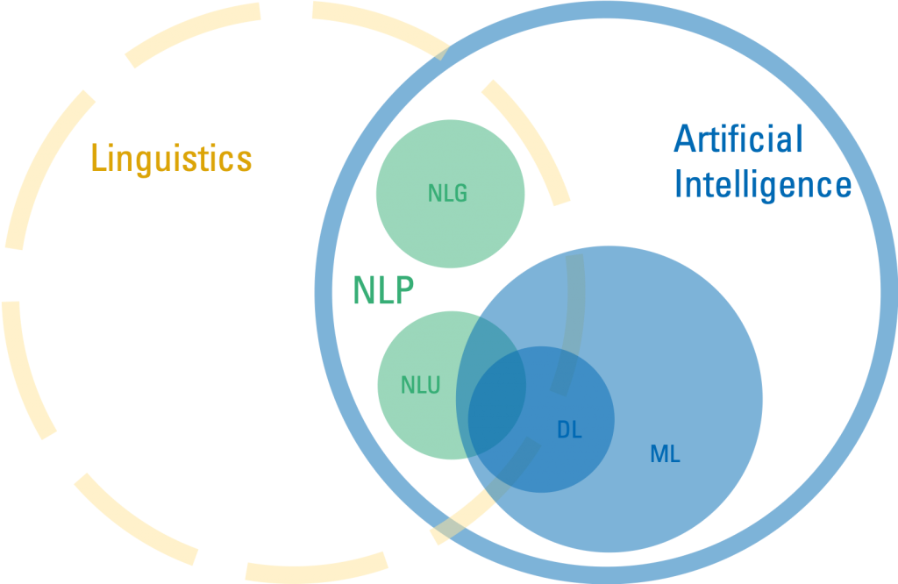
Where does NLP fit in the AI ecosystem?
Ref - https://www.retresco.com/how-to-ai-natural-language-processing/

Slide 4


Do you want to build machines or computer applications?
Do you want a machine to listen and act like humans do?
Technological
Goals
Cognitive
Goals

Slide 5
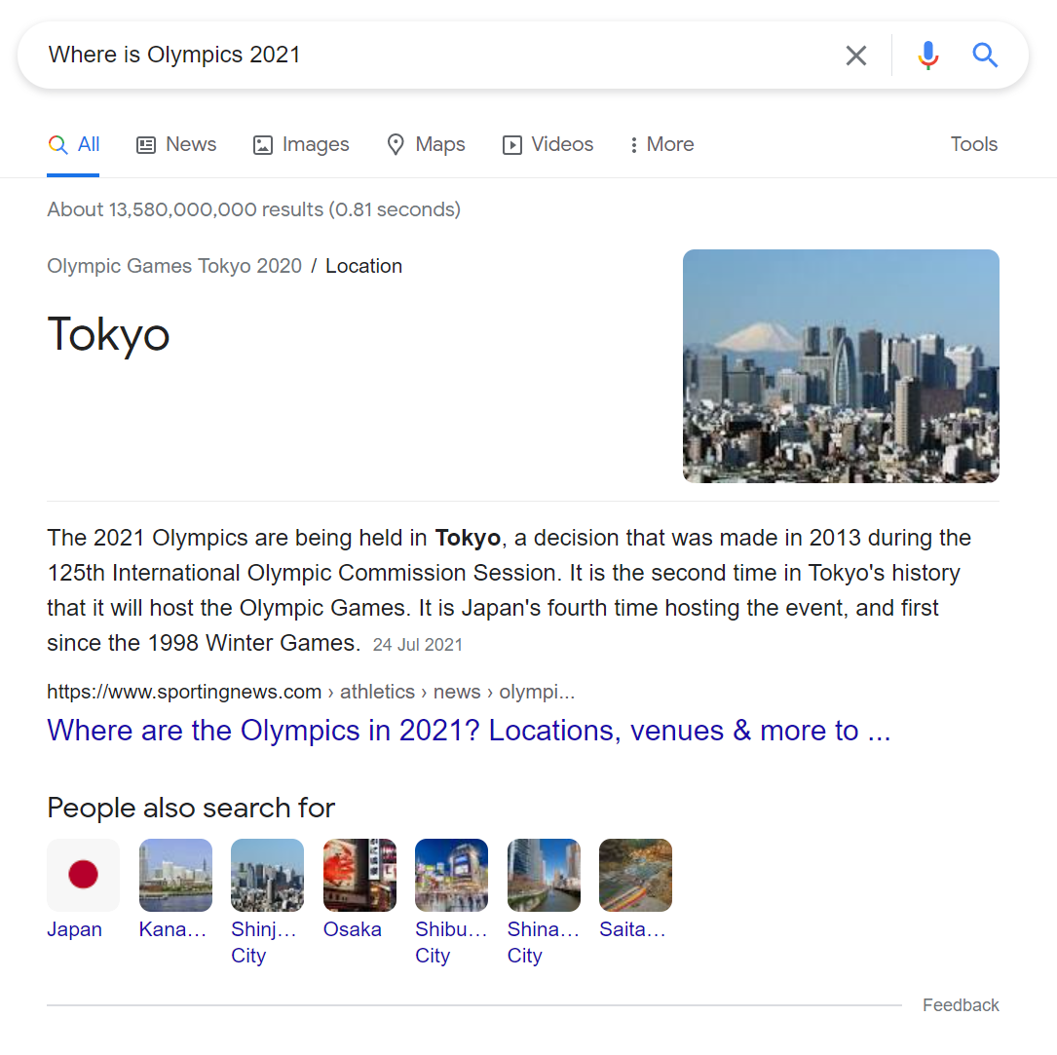
Question
Answering
NLP Application

Slide 6
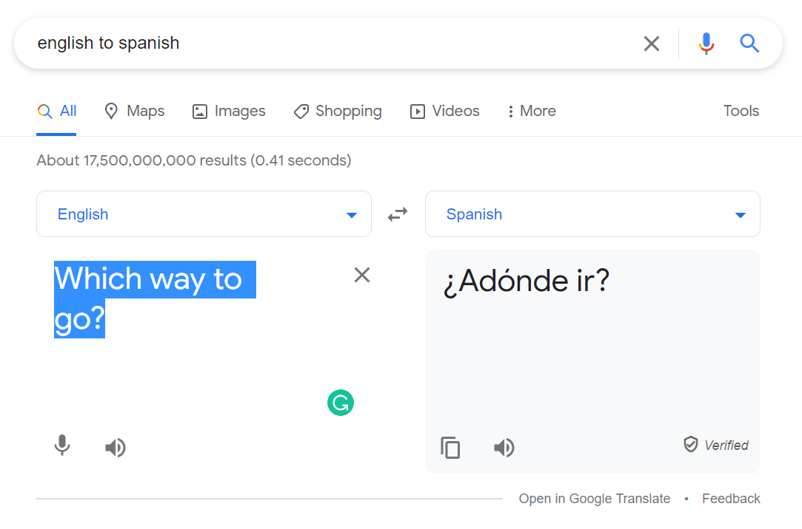
Machine
Translation
NLP Application

Slide 7
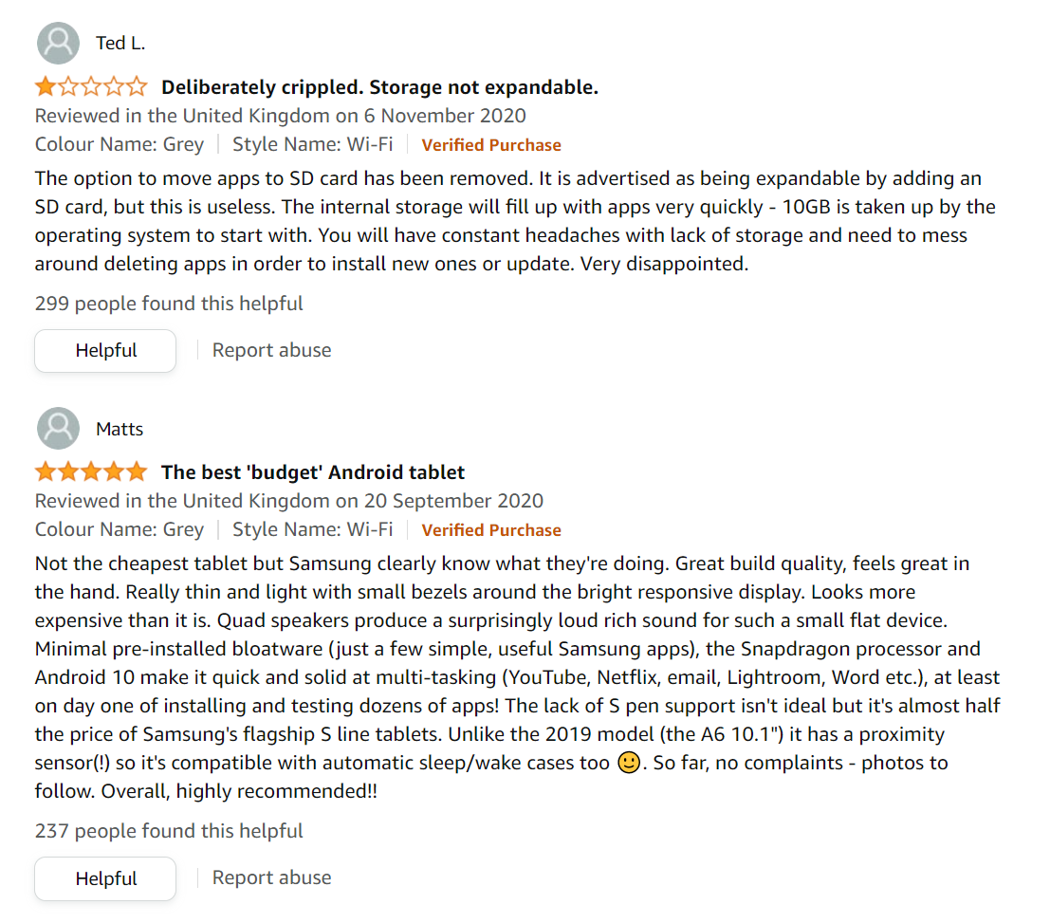
SENTIMENT
ANALYSIS
NLP Application

Slide 8
What Do You Mean? It’s kinda AMBIGUOUS!
Local High School Dropouts Cut in Half
Singular : Plural :: bird : birds :: fish : fish :: chip : chips
She was the dark horse.
Harry Potter is amazing.
That’ sit, gr888 job!!!
I retweeted the post.
I was driving through the Dublin-Limerick motorway.

Slide 9
REFERENCES
https://www.youtube.com/playlist?list=PLoROMvodv4rOFZnDyrlW3-nI7tMLtmiJZ
http://web.stanford.edu/class/cs224u/

